Slide 1
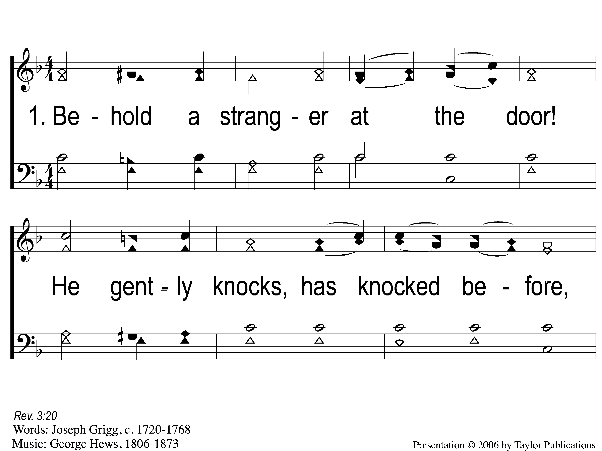
1-1 Behold a Stranger at the Door
Behold A Stranger At the Door
36

Slide 2
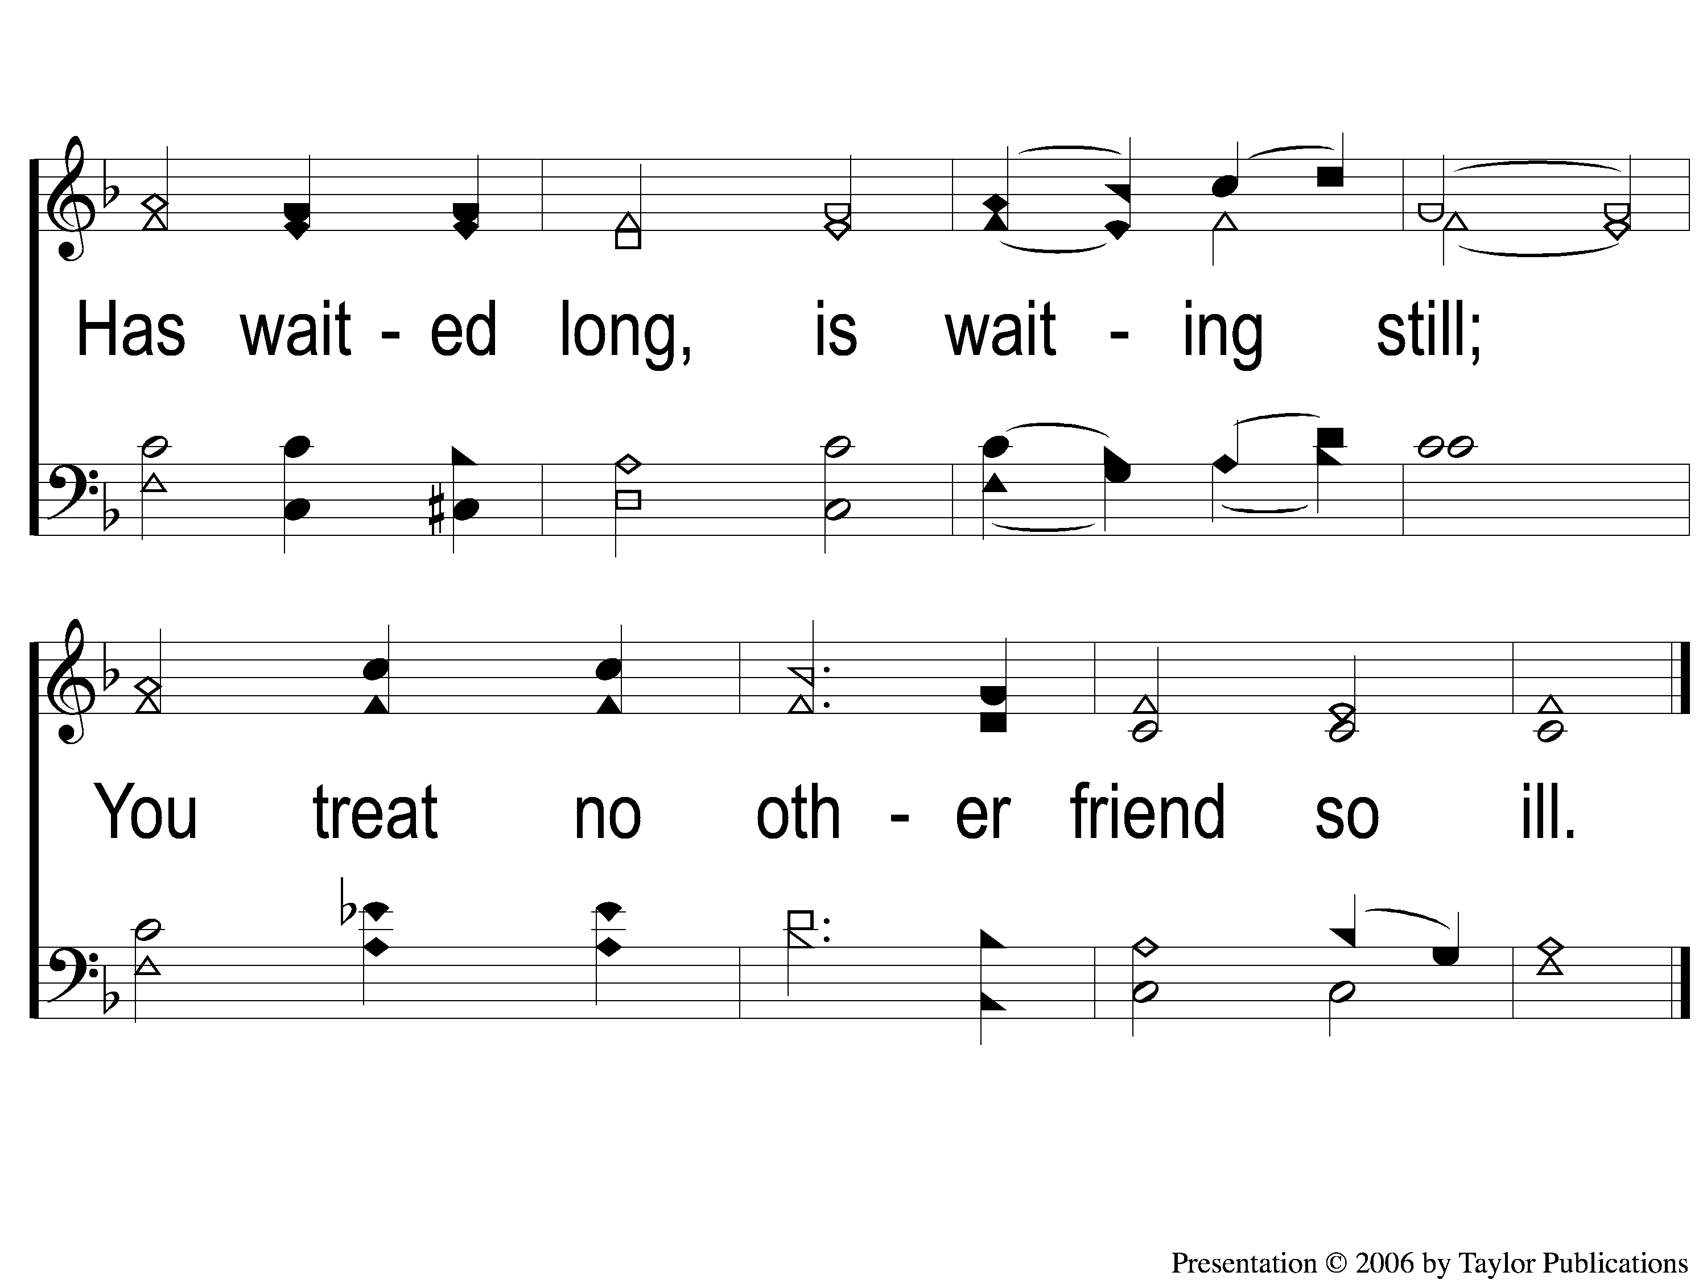
1-2 Behold a Stranger at the Door
Behold A Stranger At the Door
36

Slide 3
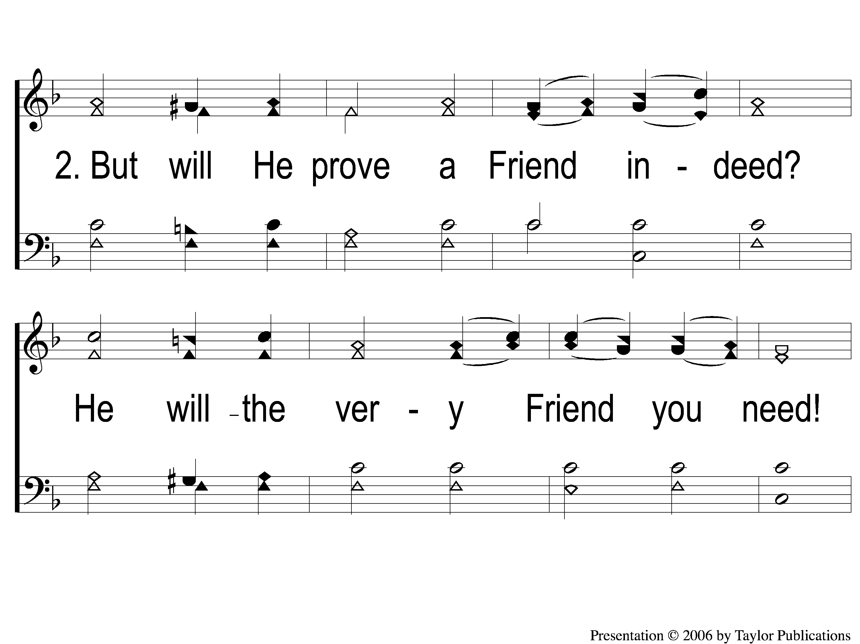
2-1 Behold a Stranger at the Door
Behold A Stranger At the Door
36

Slide 4
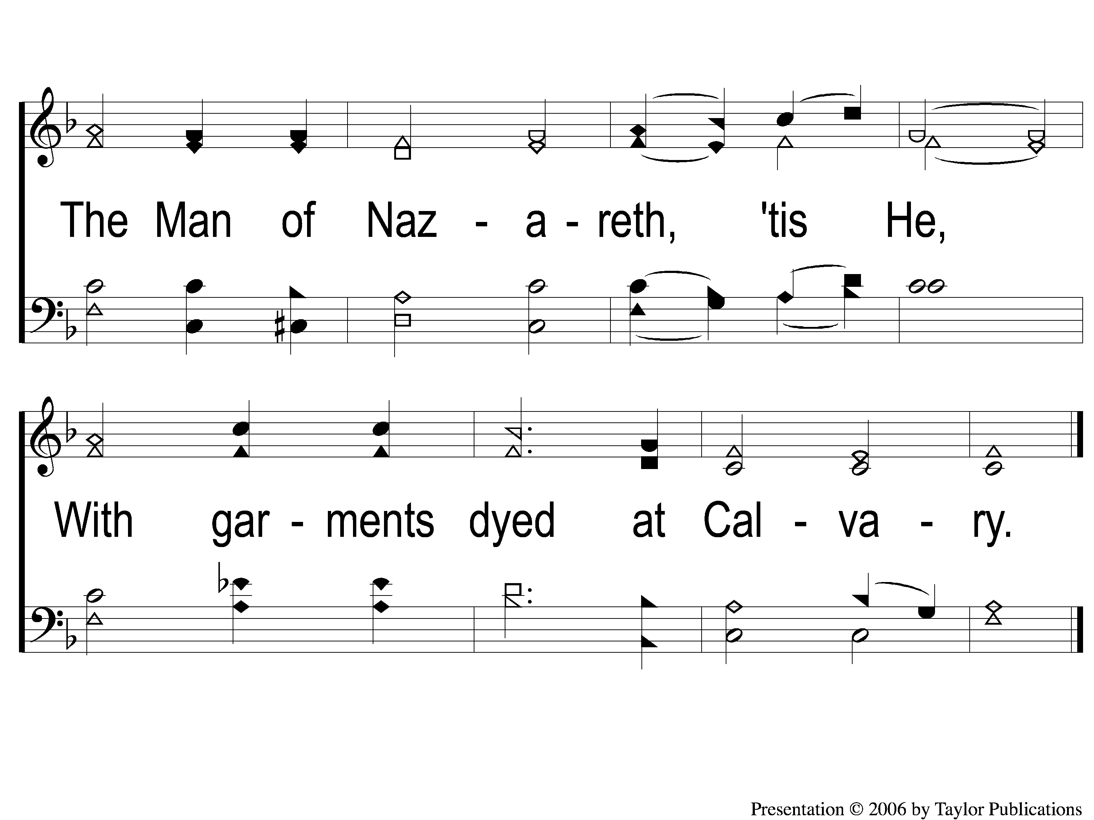
2-2 Behold a Stranger at the Door
Behold A Stranger At the Door
36

Slide 5
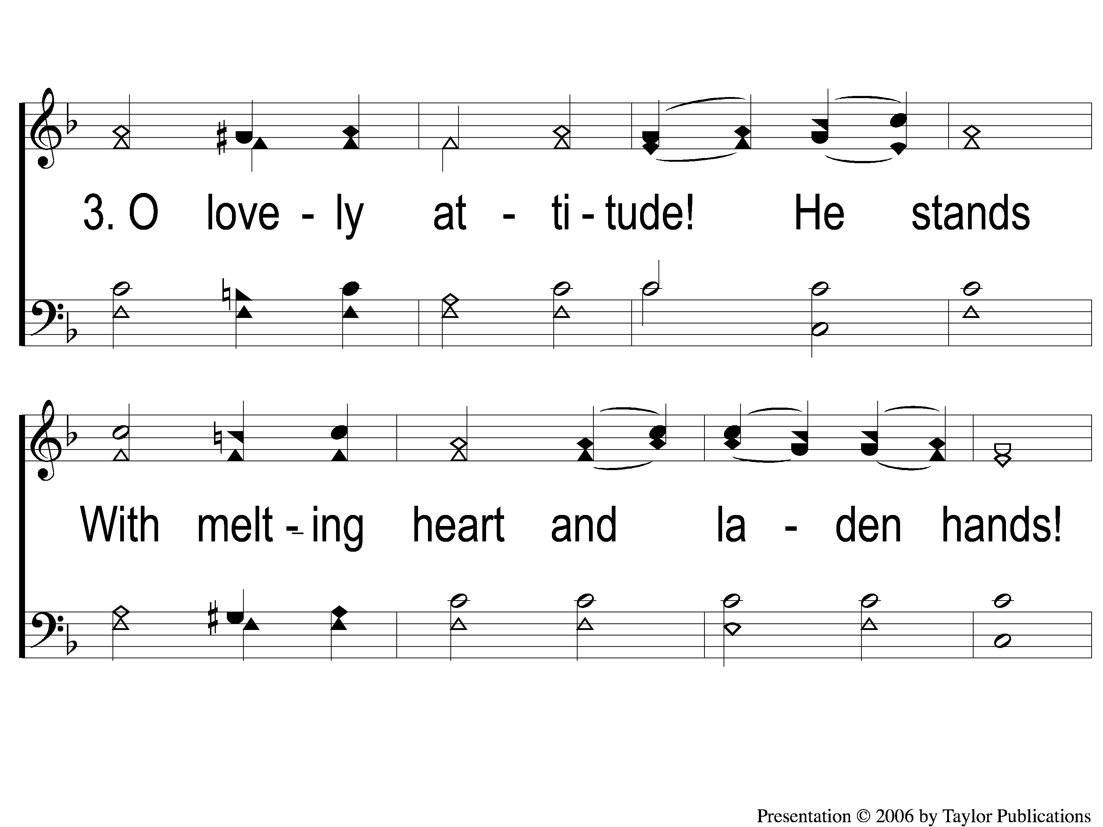
3-1 Behold a Stranger at the Door
Behold A Stranger At the Door
36

Slide 6
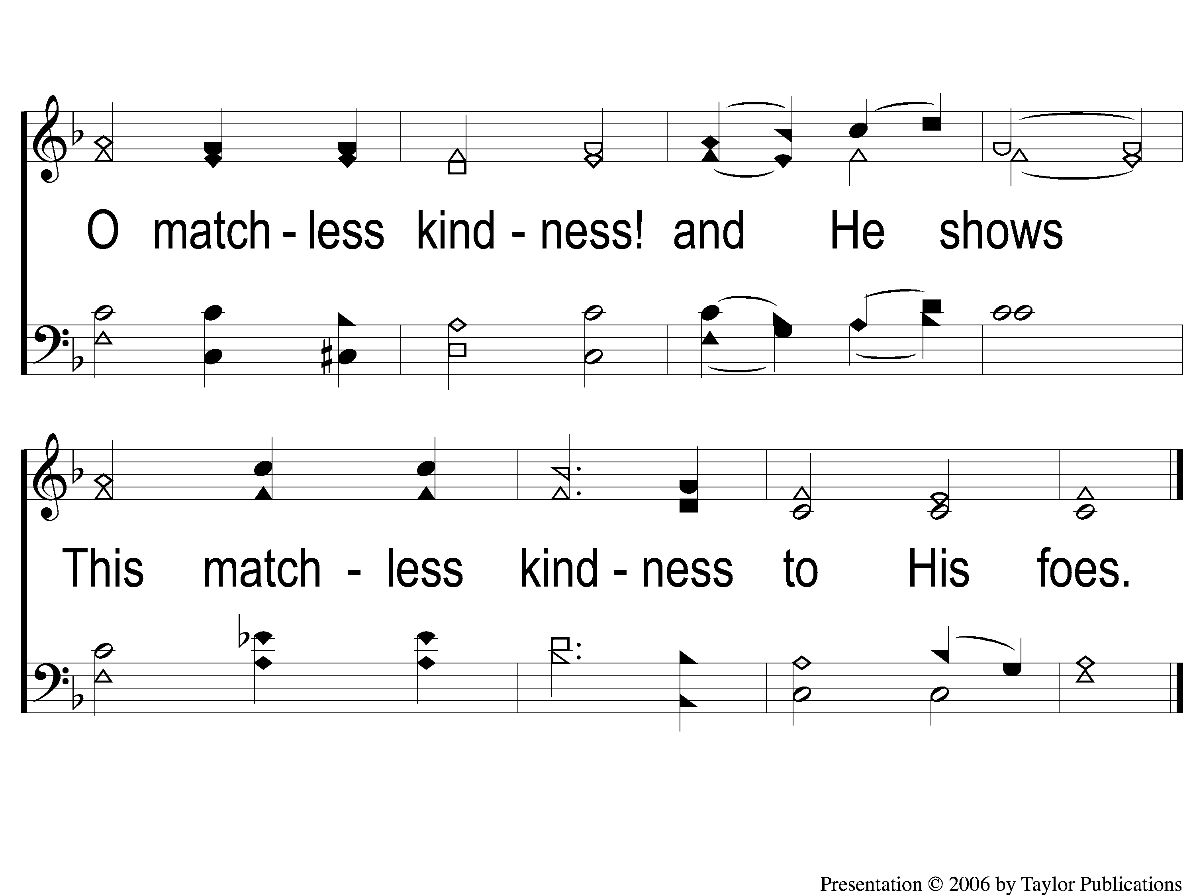
3-2 Behold a Stranger at the Door
Behold A Stranger At the Door
36

Slide 7
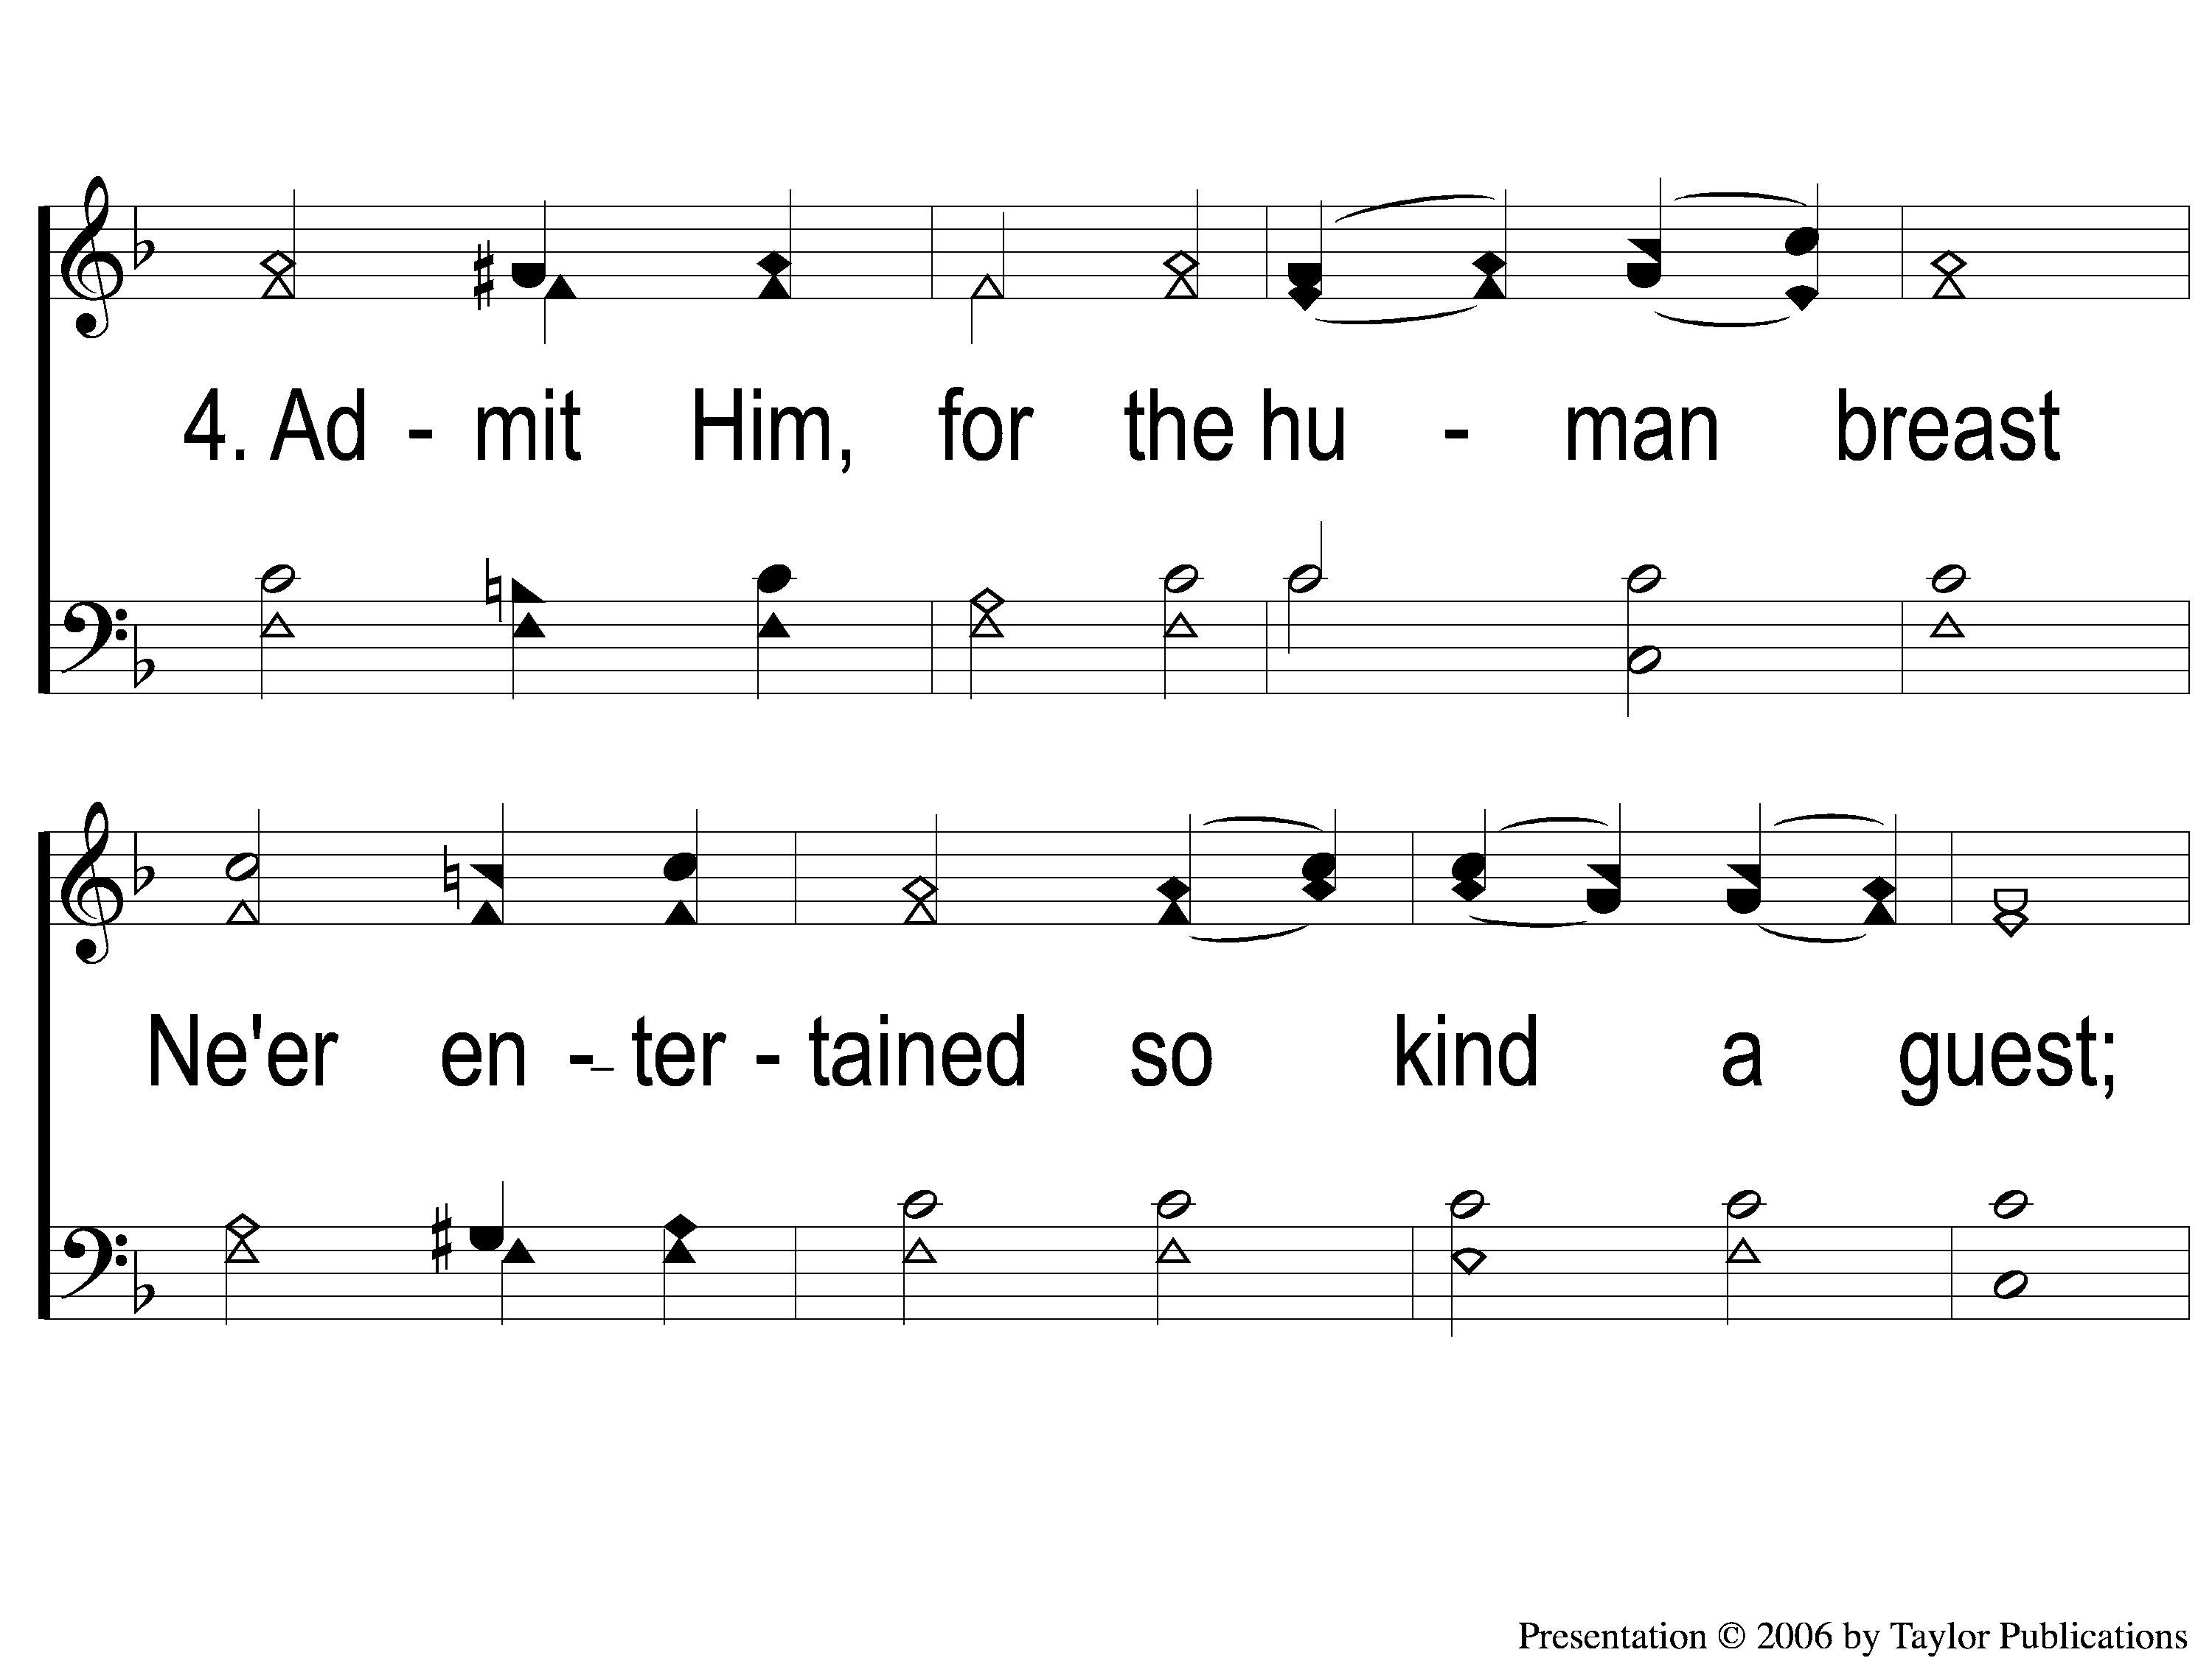
4-1 Behold a Stranger at the Door
Behold A Stranger At the Door
36

Slide 8
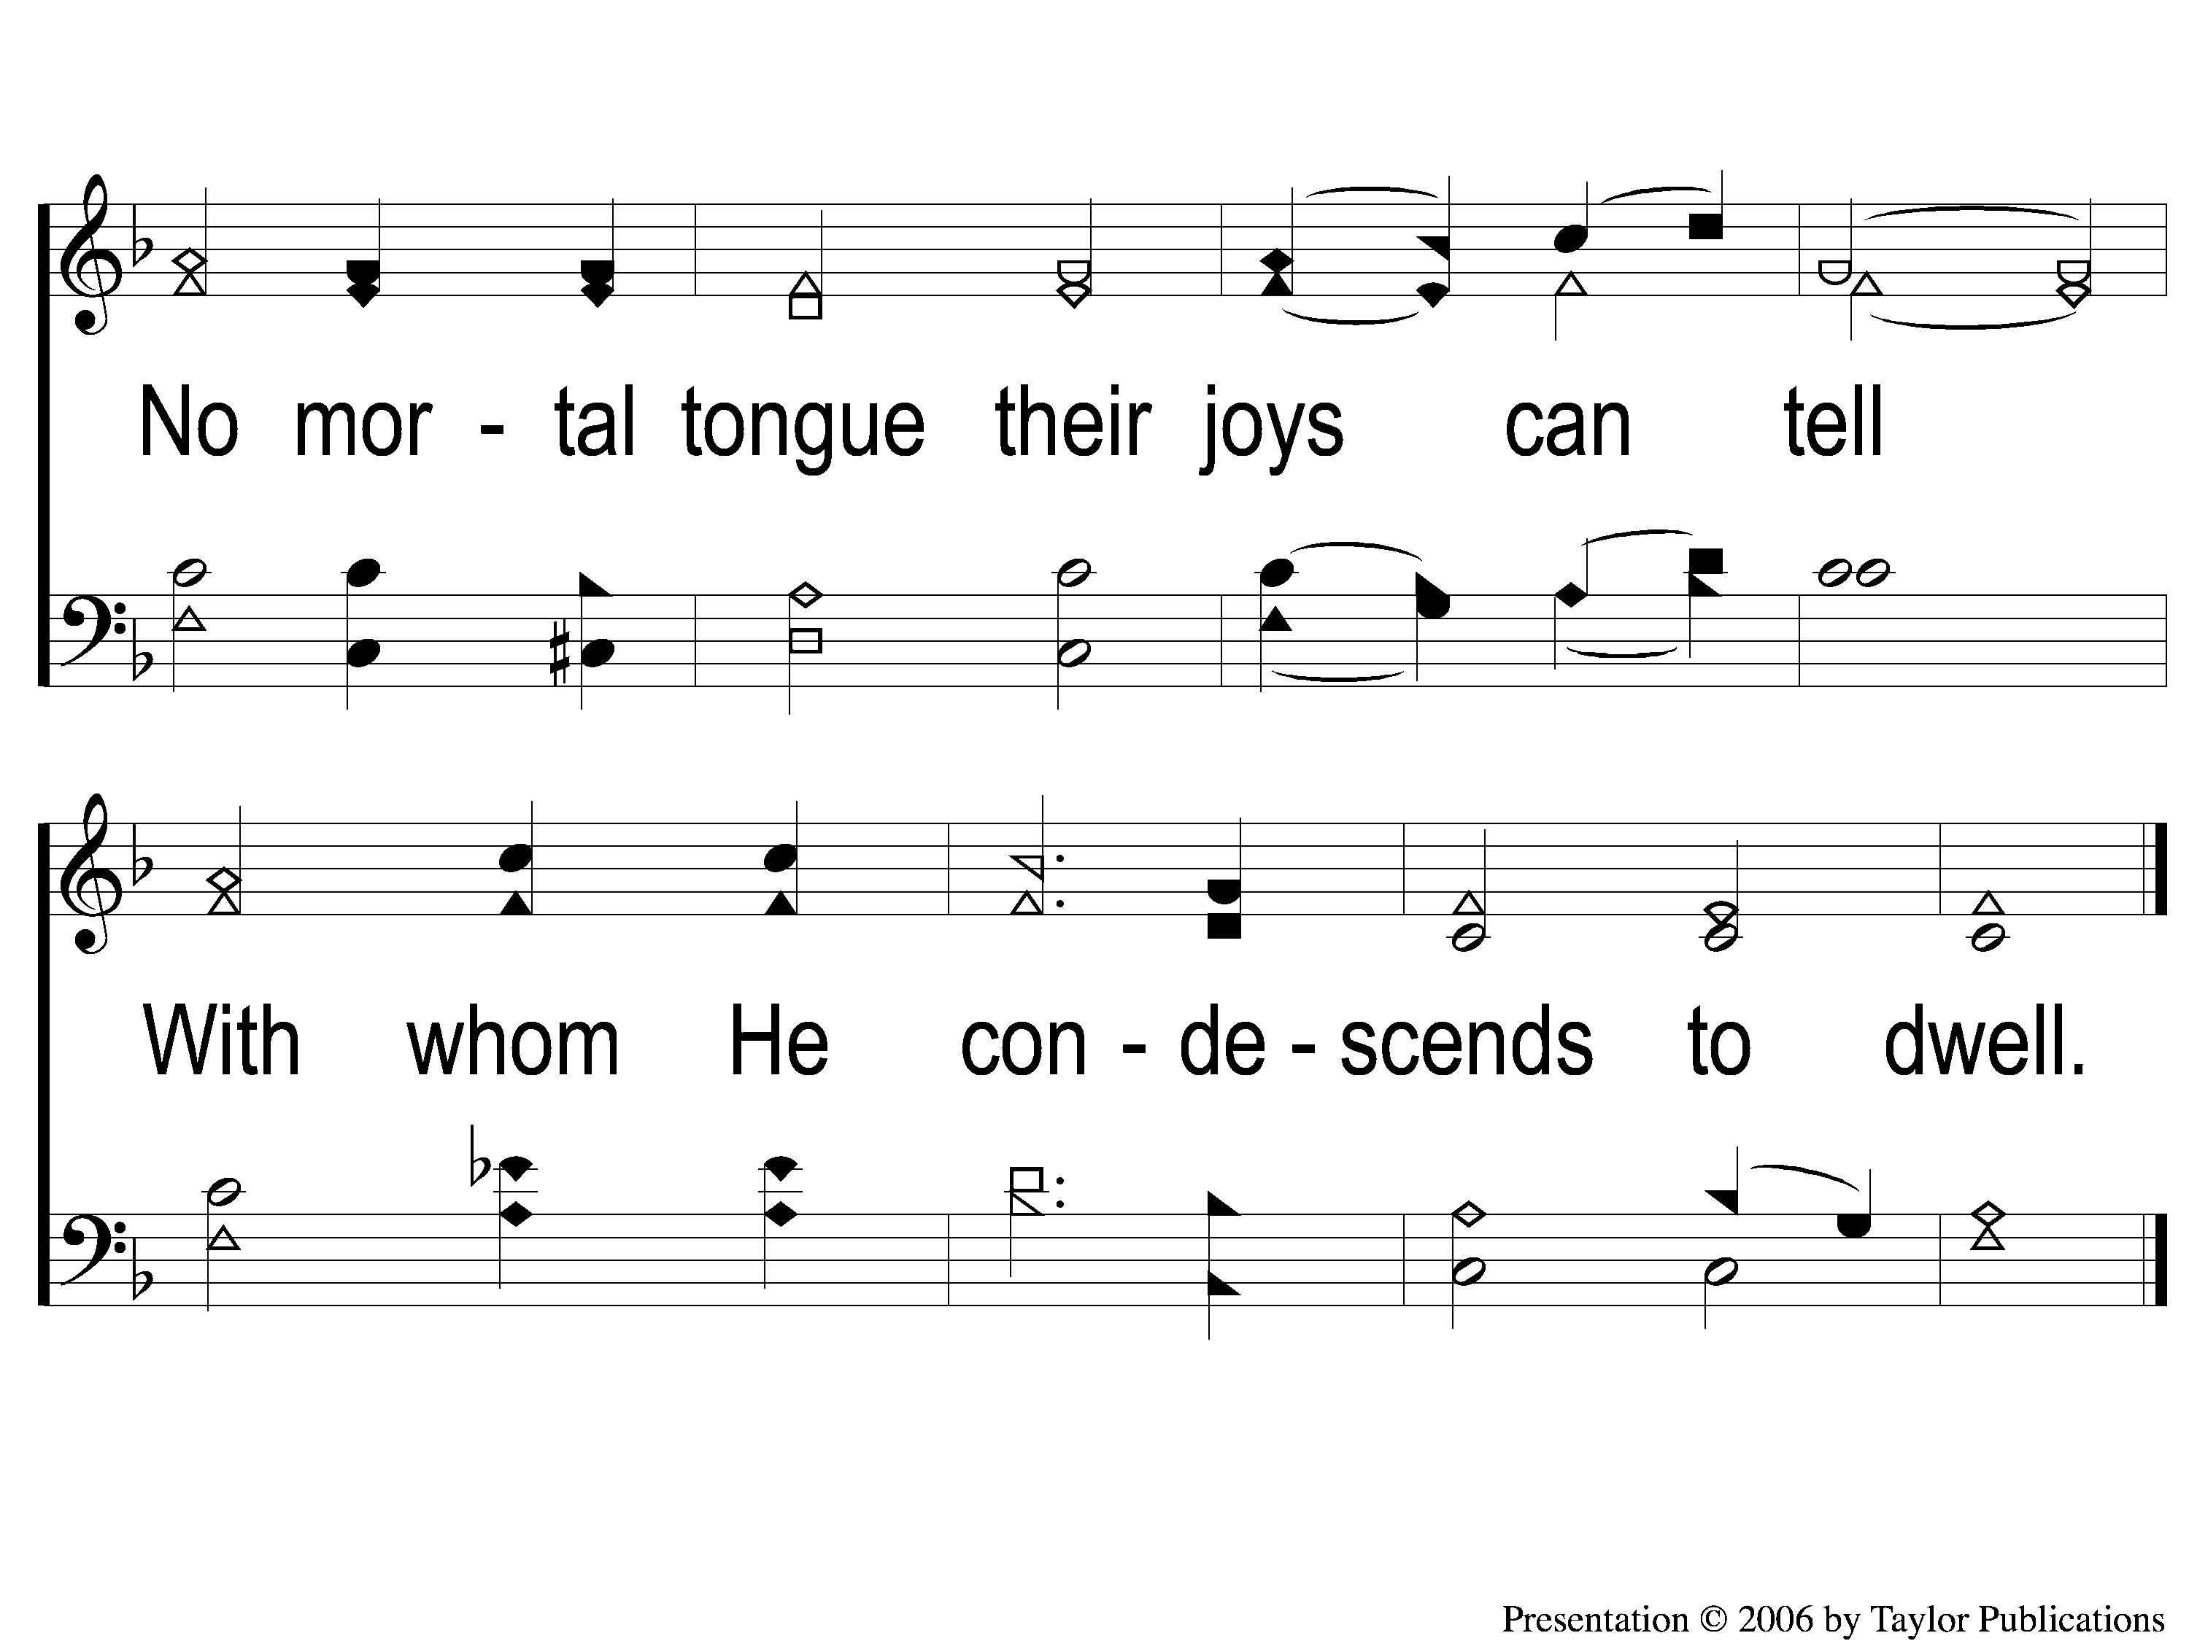
4-2 Behold a Stranger at the Door
Behold A Stranger At the Door
36

